Slide 1
The Wert plan: evidence from the introduction of the LOGSE
Sergi Jiménez-Martín (Universitat Pompeu Fabra & Fedea)
Workshop Ivalua, Barcelona, 27/06/2013

Slide 2
Motivation
Dropout rates are key to the public debate on education because they affect the overall economic performance by worsening the perspectives on the labour market and society (unemployment, social exclusion, criminal activity).
LOGSE: probably the only educational reform in Europe increasing (sustaining) dropout rates
Key factor: removal of the FP-I track
If the key factor is the FP-I, then reintroduction o a lower vocational track may help reducing dropout rates.

Slide 3
Motivation: Educational reforms in Europe

Slide 4
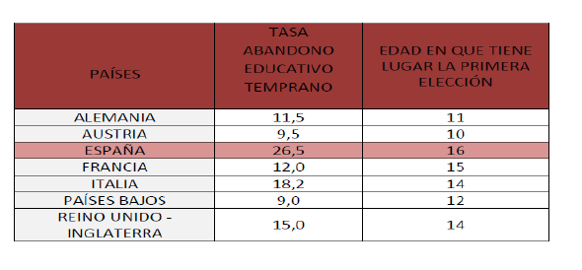
Motivation: Age of track choice and dropout
However, Brunello and Checchi or Woessmann, find that early tracking may exacerbate both educational & opportunities inequalities

Slide 5
Motivation: Educational reforms in Europe

Slide 6
Research question
What are the effects of the change in the educational law (EL) (introduction of the LOGSE)
on dropout rates?
on the track choice between post compulsory vocational and non-vocational studies?
The introduction of the LOGSE constitutes a (quasi) natural experiment.
Innovative data set: LFS data for 1995-2010.

Slide 7
Spain: stylised facts (I)
Current dropout rates are among the highest in the EU: 26.5% vs. 13.5 (EU27) in 2011.
Dropout rates decreased from 70% in 1977 to 30% at the end of the 90s, but has remained at roughly 30% until 2008.
Less % of dropout among women.
Immigration is only partly responsible of the stagnancy of dropout rates in the last decade.
new challenge since dropout rates of immigrants are nearly 17 points higher than those of natives & the weight of immigrant students at the compulsory secondary education (ESO) will grow considerably in the next decade (see Zynovieva et al, 2008).
Track choice: Decrease in the fraction studying vocational track after the introduction of the LOGSE

Slide 8
Spain: stylised facts (II)
(*) Percentage of the male population aged 18-24 with at most lower secondary education and not in further education or training.
Source: EPA (2nd quarters, sidi1 != 1 & isced == 1)

Slide 9
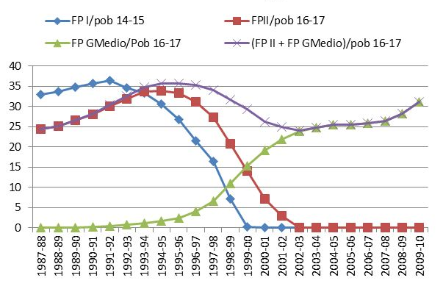
Trends in Vocational track choice

Slide 10
Educational Laws in Spain
LGE- Ley General de la Educación, 1970.
LOGSE- Ley Orgánica de Ordenación General del Sistema Educativo, 1990.
LOCE- Ley Orgánica de Calidad de la Educación, 2002.
LOE – Ley Orgánica de Educación, 2006.
LOMCE- 2014 ¿?

Slide 11
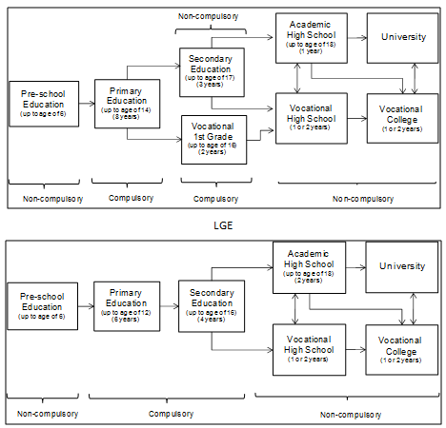
LGE LOGSE (I)
Restructuring the educational system
Source: López-Mayan (2010).

Slide 12
LGE LOGSE (I)
Compulsory education was extended from 14 to 16 years old (the minimum age to participate in the labour market):
Restructuring the transition to compulsory secondary education
(Late) LGE: Students who completed the elementary education at 14 years old could continue to non-compulsory secondary education (Bachiller); otherwise, they could go to the low level Vocational studies (FP-I).
LOGSE: Secondary compulsory school starts at the age of 12 and those students who do not complete primary school must continue in the “academic” secondary school until the age of 16. This is the result of eliminating FP-I.

Slide 13
The identification strategy (II): Different timing in the implementation of the LOGSE across regions
SIMILAR PICTURES FOR THE INTRODUCTION OF ESO1, ESO2 AND THE REMOVAL OF FP-l can be constructed.

Slide 14
Exploring the implementation of the LOGSE: its effects on the evolution of dropout
While the LOGSE was not fully in place, those who did not complete elementary education had to undertake FP-I until they were 16 years old.
During this transition, only the ‘good’ students undertook secondary school (since the elementary education ‘failures’ could still go to FP-I until they were 16 years old). As a result, the negative peer-effects of joining ‘good’ and ‘bad’ students was more limited.
Once the LOGSE was fully implemented: ‘bad’ students at 14 had to continue compulsory secondary education until they were16, together with the ‘good’ ones, and hence negative peer-effects could be larger.

Slide 15
Two empirical exercises:
A natural experiment analysis using individual data from the EPA and macro regional economic variables
Robustness checks: different samples (immigration and age)
Extensions: quarter of birth
Analysis of the track choice after compulsory education (uses the same methodology as exercise II).

Slide 16
Exercise I-II (a): A quasi-natural experiment using individual data from the EPA and regional variation of the policy variables
Estimate the individual probability of dropout controlling for different measures of exposure of the LOGSE, demographic characteristics, time and regional dummies.
Model:
y*: propensity to dropout of individual i from birth cohort q in region r;
X: vector of individual and family characteristics;
T: treatment (1 if exposed to the LOGSE, and 0 if exposed to the LGE) ;
Z: vector or regional controls at the time of entry in the labour market.
Since y* is unobservable, we define
Dependent variable: Exercise II (1 if individual is a dropout; otherwise, it takes value 0). Exercise III (1 if individual takes vocational studies after compulsory education; 0 otherwise).
Data (key): LFS 1995-2010. 1st interview only.

Slide 17
Exercise II-III (b): Methodology
Since the introduction of the LOGSE progressed differerently across schools and regions we do not know whether an individual was exposed to the treatment or not. We may consider three periods:
Before 1991: only LGE, treatment=0.
1991-1999: LGE and LOGSE coexist with differences across regions.
2000+: only LOGSE, treatment=1
Had we known for each individual the system under he/she studied we would have used that variable as our treatment for evaluating the impact of the law.
Instead, we use the exposure to the treatment for periods when both the LGE and LOGSE coexist.

Slide 18
Exercise II-III (c): Methodology
During 1991-1999, we proxy exposure to the treatment by three different indicators representing the fraction of people studying under the LOGSE.
We know that in a particular region and year, the proportion of students within a certain age band under the LOGSE system was x. We then allocate this x to that individual according to his/her date of birth, which becomes his/her index of exposure of the LOGSE as in Duflo (2000), Donahue and Lewitt (2001) or Wolfers (2006).
Instruments of the exposure to the treatment
Exposure to ESO at ages 12-17
or Lower ESO / (Lower ESO + 7 EGB + 8 EGB): % of students aged 12 and 13 years old that are under the LOGSE;
+ FRACTION STUDYING FP-I
Other covariates: Fam. Charact., LM+BC, other.....

Slide 19
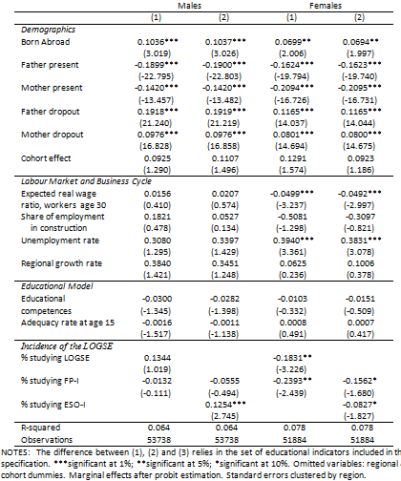
The probability of dropout. 1976-1986 cohorts interviewed at ages 18-24 in 1995-2010.

Slide 20
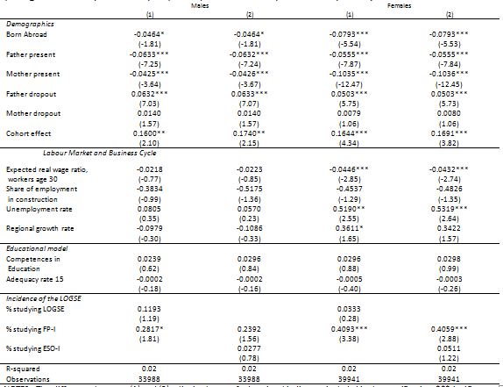
Track choice

Slide 21
Conclusions (I)
Results show a positive relationship between the LOGSE and the incidence of school dropout for men. The effect is the opposite for women.
The abolishment of FP-1 (Lower Vocational studies) for children aged 14 to 16 years old that took place after the implementation of the LOGSE had a negative impact on the willingness to continue studying.
Thus, for girls mixing the good and the bad students in the same class (in the last two courses of the new track) is likely to have negative consequences.
Track choice: Removal of FP-1 lowered the probability of choosing the vocational track.

Slide 22
Conclusions
Thus, we expect positive effects of reintroducing some flexibility into the system. For example, (voluntary) tracking (some short of basic vocational studies) after age 14 on student’s dropout rates.
Evidence on PCPI mildly supports the above claim
Recent policy measures (LOMCE) go in this direction.
Increasing the flexibility of the Compulsory Secondary Education may have beneficial effects for the whole educational system
Further measures in other educational stages (Upper Vocational & University) are needed.

