Slide 1
On puc trobar i consultar avaluacions útils?
Presentació del nou Repositori d’avaluacions de polítiques públiques
Marçal Farré i Andreu Orte

Slide 2
Què explicarem en aquest webinar?
Què és el repositori d’avaluacions?
Què conté ara mateix?
Naveguem pel repositori
Cas pràstic
1
2
3
4

Slide 3


Què és el repositori d’avaluacions?

Slide 4

Què és el repositori d’avaluacions?
“Es un web que recull de forma sistemàtica avaluacions de polítiques públiques dutes a terme a Catalunya, ja sigui per part de les administracions públiques o per part del tercer sector social, i ofereix un resum de les principals característiques i resultats de cada avaluació, així com de les conclusions i recomanacions formulades pels seus autors.”
https://www.upf.edu/web/avaluacions-politiques-publiques
Notes:
Beneficis TdC:
Pot ajudar a trobar una narrativa comuna entre actors
Veure el programa en la seva globalitat
Permet comunicar millor què fem.
Motivation to understand the context and situation as a starting point for planning programmes, bringing critical thinking to bear on the assumptions around a programme, and to make the views on how the programme is expected to work transparent
Developing a common understand of the work and surfacing differences in perspective in a positive way
Strengthening the clarity, effectiveness and focus of programmes
More flexible alternative to working with log-­‐frames for complex programmes and contexts
Using theory of change as a framework from which to assess impact and improve monitoring and evaluation, to test the assumptions, demonstrate impact and learn from it
Improving relationships with partners and stakeholders by identifying opportunities for dialogue and collaboration
Providing a unifying framework for strategic decision-­‐making, communicating and reporting.
Wanting to have a clearer conceptualisation of ‘impact’ and understanding the intermediate changes that have significance for programmes and stakeholders and to enable strategies to be optimized
Strengthening adaptive management, responsiveness to changes in the contextLooking to find new ways of bringing rigour to the evaluation of complex and emergent change in difficult areas like governance.

Slide 5



Què és el repositori d’avaluacions?
https://www.upf.edu/web/avaluacions-politiques-publiques
Protocol de cerca, criteris d’inclusió i exclusió
Camps de registre de la informació
Notes:
Beneficis TdC:
Pot ajudar a trobar una narrativa comuna entre actors
Veure el programa en la seva globalitat
Permet comunicar millor què fem.
Motivation to understand the context and situation as a starting point for planning programmes, bringing critical thinking to bear on the assumptions around a programme, and to make the views on how the programme is expected to work transparent
Developing a common understand of the work and surfacing differences in perspective in a positive way
Strengthening the clarity, effectiveness and focus of programmes
More flexible alternative to working with log-­‐frames for complex programmes and contexts
Using theory of change as a framework from which to assess impact and improve monitoring and evaluation, to test the assumptions, demonstrate impact and learn from it
Improving relationships with partners and stakeholders by identifying opportunities for dialogue and collaboration
Providing a unifying framework for strategic decision-­‐making, communicating and reporting.
Wanting to have a clearer conceptualisation of ‘impact’ and understanding the intermediate changes that have significance for programmes and stakeholders and to enable strategies to be optimized
Strengthening adaptive management, responsiveness to changes in the contextLooking to find new ways of bringing rigour to the evaluation of complex and emergent change in difficult areas like governance.

Slide 6
Teoria del Canvi d’Ivàlua
Polítiques públiques informades de l’evidència
Evidència rigorosa, disponible i accesible
Decisors públics formats en l’ús de l’evidència
Repositori
Síntesi de l’evidència local i internacional
Avaluacions de polítiques públiques locals
Jornades i actes de difusió de l’evidència
Formació en avaluació a tècnics i decisors pùblics
Recursos i acompanyament tècnic a les organizacions
Notes:
Beneficis TdC:
Pot ajudar a trobar una narrativa comuna entre actors
Veure el programa en la seva globalitat
Permet comunicar millor què fem.
Motivation to understand the context and situation as a starting point for planning programmes, bringing critical thinking to bear on the assumptions around a programme, and to make the views on how the programme is expected to work transparent
Developing a common understand of the work and surfacing differences in perspective in a positive way
Strengthening the clarity, effectiveness and focus of programmes
More flexible alternative to working with log-­‐frames for complex programmes and contexts
Using theory of change as a framework from which to assess impact and improve monitoring and evaluation, to test the assumptions, demonstrate impact and learn from it
Improving relationships with partners and stakeholders by identifying opportunities for dialogue and collaboration
Providing a unifying framework for strategic decision-­‐making, communicating and reporting.
Wanting to have a clearer conceptualisation of ‘impact’ and understanding the intermediate changes that have significance for programmes and stakeholders and to enable strategies to be optimized
Strengthening adaptive management, responsiveness to changes in the contextLooking to find new ways of bringing rigour to the evaluation of complex and emergent change in difficult areas like governance.

Slide 7
Objectius del repositori
Promoure la cultura de l’evidència i l’avaluació
Donar visibilitat a les avaluacions existents i a la gent que hi participa (ja sigui encarregant-les o realitzant-les)
Notes:
Beneficis TdC:
Pot ajudar a trobar una narrativa comuna entre actors
Veure el programa en la seva globalitat
Permet comunicar millor què fem.
Motivation to understand the context and situation as a starting point for planning programmes, bringing critical thinking to bear on the assumptions around a programme, and to make the views on how the programme is expected to work transparent
Developing a common understand of the work and surfacing differences in perspective in a positive way
Strengthening the clarity, effectiveness and focus of programmes
More flexible alternative to working with log-­‐frames for complex programmes and contexts
Using theory of change as a framework from which to assess impact and improve monitoring and evaluation, to test the assumptions, demonstrate impact and learn from it
Improving relationships with partners and stakeholders by identifying opportunities for dialogue and collaboration
Providing a unifying framework for strategic decision-­‐making, communicating and reporting.
Wanting to have a clearer conceptualisation of ‘impact’ and understanding the intermediate changes that have significance for programmes and stakeholders and to enable strategies to be optimized
Strengthening adaptive management, responsiveness to changes in the contextLooking to find new ways of bringing rigour to the evaluation of complex and emergent change in difficult areas like governance.

Slide 8

Què conté ara mateix?

Slide 9
Què conté ara mateix?
Un total de 99 avaluacions....
Per tipus d’avaluació:
Notes:
Beneficis TdC:
Pot ajudar a trobar una narrativa comuna entre actors
Veure el programa en la seva globalitat
Permet comunicar millor què fem.
Motivation to understand the context and situation as a starting point for planning programmes, bringing critical thinking to bear on the assumptions around a programme, and to make the views on how the programme is expected to work transparent
Developing a common understand of the work and surfacing differences in perspective in a positive way
Strengthening the clarity, effectiveness and focus of programmes
More flexible alternative to working with log-­‐frames for complex programmes and contexts
Using theory of change as a framework from which to assess impact and improve monitoring and evaluation, to test the assumptions, demonstrate impact and learn from it
Improving relationships with partners and stakeholders by identifying opportunities for dialogue and collaboration
Providing a unifying framework for strategic decision-­‐making, communicating and reporting.
Wanting to have a clearer conceptualisation of ‘impact’ and understanding the intermediate changes that have significance for programmes and stakeholders and to enable strategies to be optimized
Strengthening adaptive management, responsiveness to changes in the contextLooking to find new ways of bringing rigour to the evaluation of complex and emergent change in difficult areas like governance.

Slide 10
Què conté ara mateix?
Un total de 99 avaluacions....
Segons qui la realitza:
Notes:
Beneficis TdC:
Pot ajudar a trobar una narrativa comuna entre actors
Veure el programa en la seva globalitat
Permet comunicar millor què fem.
Motivation to understand the context and situation as a starting point for planning programmes, bringing critical thinking to bear on the assumptions around a programme, and to make the views on how the programme is expected to work transparent
Developing a common understand of the work and surfacing differences in perspective in a positive way
Strengthening the clarity, effectiveness and focus of programmes
More flexible alternative to working with log-­‐frames for complex programmes and contexts
Using theory of change as a framework from which to assess impact and improve monitoring and evaluation, to test the assumptions, demonstrate impact and learn from it
Improving relationships with partners and stakeholders by identifying opportunities for dialogue and collaboration
Providing a unifying framework for strategic decision-­‐making, communicating and reporting.
Wanting to have a clearer conceptualisation of ‘impact’ and understanding the intermediate changes that have significance for programmes and stakeholders and to enable strategies to be optimized
Strengthening adaptive management, responsiveness to changes in the contextLooking to find new ways of bringing rigour to the evaluation of complex and emergent change in difficult areas like governance.

Slide 11
Què conté ara mateix?
Un total de 99 avaluacions....
Per àmbit:
Notes:
Beneficis TdC:
Pot ajudar a trobar una narrativa comuna entre actors
Veure el programa en la seva globalitat
Permet comunicar millor què fem.
Motivation to understand the context and situation as a starting point for planning programmes, bringing critical thinking to bear on the assumptions around a programme, and to make the views on how the programme is expected to work transparent
Developing a common understand of the work and surfacing differences in perspective in a positive way
Strengthening the clarity, effectiveness and focus of programmes
More flexible alternative to working with log-­‐frames for complex programmes and contexts
Using theory of change as a framework from which to assess impact and improve monitoring and evaluation, to test the assumptions, demonstrate impact and learn from it
Improving relationships with partners and stakeholders by identifying opportunities for dialogue and collaboration
Providing a unifying framework for strategic decision-­‐making, communicating and reporting.
Wanting to have a clearer conceptualisation of ‘impact’ and understanding the intermediate changes that have significance for programmes and stakeholders and to enable strategies to be optimized
Strengthening adaptive management, responsiveness to changes in the contextLooking to find new ways of bringing rigour to the evaluation of complex and emergent change in difficult areas like governance.

Slide 12

Naveguem pel repositori

Slide 13
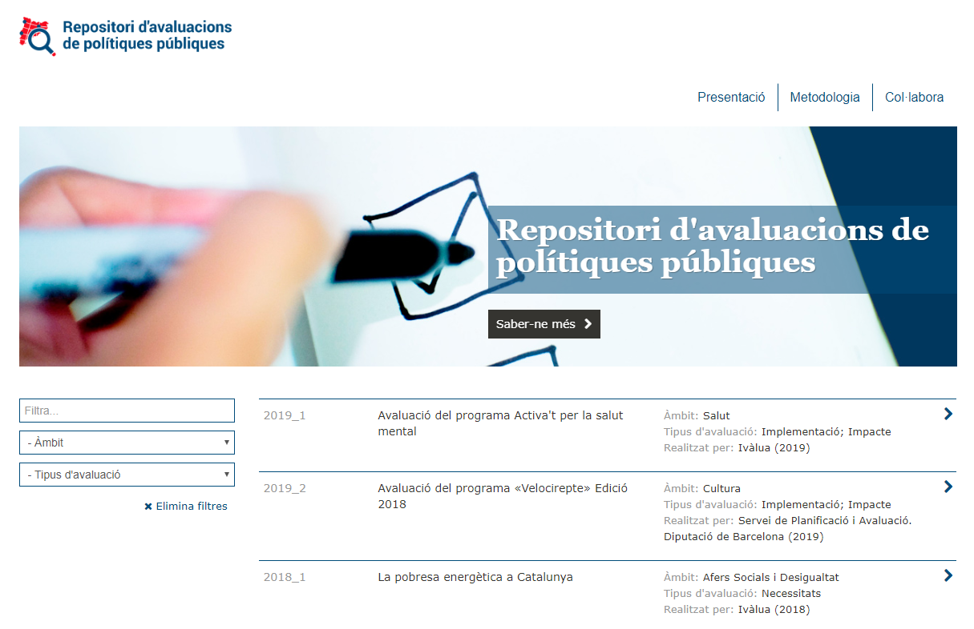
Notes:
Beneficis TdC:
Pot ajudar a trobar una narrativa comuna entre actors
Veure el programa en la seva globalitat
Permet comunicar millor què fem.
Motivation to understand the context and situation as a starting point for planning programmes, bringing critical thinking to bear on the assumptions around a programme, and to make the views on how the programme is expected to work transparent
Developing a common understand of the work and surfacing differences in perspective in a positive way
Strengthening the clarity, effectiveness and focus of programmes
More flexible alternative to working with log-­‐frames for complex programmes and contexts
Using theory of change as a framework from which to assess impact and improve monitoring and evaluation, to test the assumptions, demonstrate impact and learn from it
Improving relationships with partners and stakeholders by identifying opportunities for dialogue and collaboration
Providing a unifying framework for strategic decision-­‐making, communicating and reporting.
Wanting to have a clearer conceptualisation of ‘impact’ and understanding the intermediate changes that have significance for programmes and stakeholders and to enable strategies to be optimized
Strengthening adaptive management, responsiveness to changes in the contextLooking to find new ways of bringing rigour to the evaluation of complex and emergent change in difficult areas like governance.

Slide 14
Equip:
Direcció: Marc Balaguer i Miquel Salvador (UPF)
Cerca i registre de la informació: Marc Henríquez, Ana Baracat i Marçal Farré (Ivàlua)
Direcció d’art d’identitat visual corporativa: Jordi Miras (Ivàlua)
Desenvolupament web: Jesús Carrasco (UPF)
Notes:
Beneficis TdC:
Pot ajudar a trobar una narrativa comuna entre actors
Veure el programa en la seva globalitat
Permet comunicar millor què fem.
Motivation to understand the context and situation as a starting point for planning programmes, bringing critical thinking to bear on the assumptions around a programme, and to make the views on how the programme is expected to work transparent
Developing a common understand of the work and surfacing differences in perspective in a positive way
Strengthening the clarity, effectiveness and focus of programmes
More flexible alternative to working with log-­‐frames for complex programmes and contexts
Using theory of change as a framework from which to assess impact and improve monitoring and evaluation, to test the assumptions, demonstrate impact and learn from it
Improving relationships with partners and stakeholders by identifying opportunities for dialogue and collaboration
Providing a unifying framework for strategic decision-­‐making, communicating and reporting.
Wanting to have a clearer conceptualisation of ‘impact’ and understanding the intermediate changes that have significance for programmes and stakeholders and to enable strategies to be optimized
Strengthening adaptive management, responsiveness to changes in the contextLooking to find new ways of bringing rigour to the evaluation of complex and emergent change in difficult areas like governance.

Slide 15

Cas pràctic

Slide 16
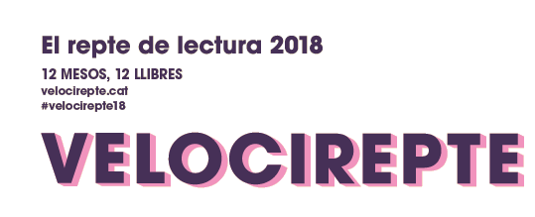



La utilitat de repositoris d’avaluació
Edició del 2018

Slide 17
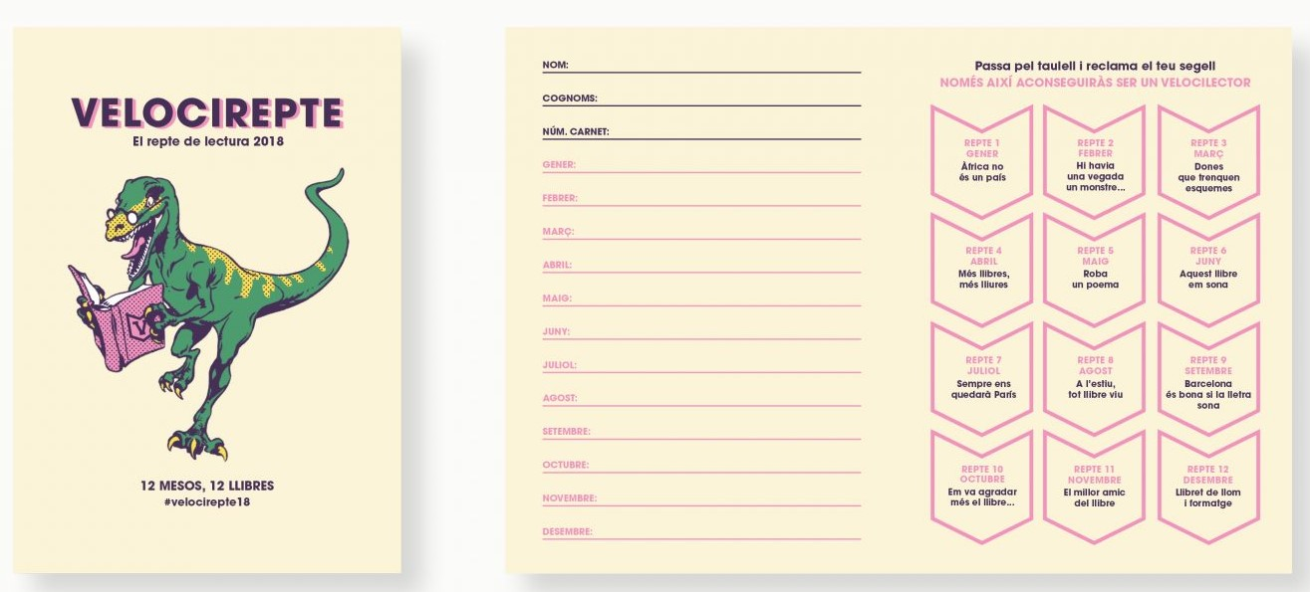




Descripció del programa​
El «Velocirepte, el repte lector» és un programa per a fomentar la lectura entre els usuaris de les Biblioteques de Barcelona.
Lectura de, com a mínim, un llibre al mes sobre un repte (tema) proposat
Butlleta
12 reptes
Obsequis
Inscripció prèvia
Sorteig premi final
Notes:
Finalment, podem pensar en aquelles situaicons no previstes o sobre les que la política pública té poc control, però que afecten als elements de la Teoría del Canvi que hem elaborat.
Des del punt de vista del disseny d’una política, si dientifiquem un risc important, podem pensar en accions de mitigació. Per exemple, en el context actual, si creiem que no seria estrany que s’endureixin les mesures de distanciament socia, podem pensar en altres formes de proveïr les tutories i el suport.

Slide 18
Objectius del Velocirepte​
Promoure la lectura entre els usuaris de les Biblioteques de Barcelona.
Descobrir nous autors i/o temàtiques que altrament no s’haurien llegit.
Notes:
Finalment, podem pensar en aquelles situaicons no previstes o sobre les que la política pública té poc control, però que afecten als elements de la Teoría del Canvi que hem elaborat.
Des del punt de vista del disseny d’una política, si dientifiquem un risc important, podem pensar en accions de mitigació. Per exemple, en el context actual, si creiem que no seria estrany que s’endureixin les mesures de distanciament socia, podem pensar en altres formes de proveïr les tutories i el suport.

Slide 19

Abast de l’avaluació​
Avaluació d’implementació
El programa ha arribat a un perfil de participant representatiu del conjunt d’usuaris de biblioteca?
El programa hi predominen els participants amb usos intensius previs?
Quin ha estat el grau del seguiment del programa? Quin ha estat el seguiment en funció del perfil dels participants?
Quin ha estat el seguiment temporal del programa? Quin és el perfil de persones que han abandonat?
Com perceben els participants el programa?
Avaluació d’impacte
Quin és l’impacte del Velocirepte en l’ús del servei de préstec entre 2017 i 2018?
Quin és l’impacte net; és a dir, descomptant els reptes superats per part dels participants?
Quin és l’impacte en funció de la intensitat de seguiment del Velocirepte?
El Velocirepte ha incidit en una variació en els usos d’altres serveis de biblioteca
(com ara l’ús del servei de wifi i d’Internet i +)?
Notes:
Finalment, podem pensar en aquelles situaicons no previstes o sobre les que la política pública té poc control, però que afecten als elements de la Teoría del Canvi que hem elaborat.
Des del punt de vista del disseny d’una política, si dientifiquem un risc important, podem pensar en accions de mitigació. Per exemple, en el context actual, si creiem que no seria estrany que s’endureixin les mesures de distanciament socia, podem pensar en altres formes de proveïr les tutories i el suport.

Slide 20
Antecedents​
Programa de promoció de la lectura a la biblioteca de “Sagrada Família” l’any 2016.
Voluntat d’arribar a tots els usuaris de biblioteca.
Introducció d’elements de ludificació.
Notes:
Finalment, podem pensar en aquelles situaicons no previstes o sobre les que la política pública té poc control, però que afecten als elements de la Teoría del Canvi que hem elaborat.
Des del punt de vista del disseny d’una política, si dientifiquem un risc important, podem pensar en accions de mitigació. Per exemple, en el context actual, si creiem que no seria estrany que s’endureixin les mesures de distanciament socia, podem pensar en altres formes de proveïr les tutories i el suport.

Slide 21
En què hauria ajudat un repositori d’avaluacions?​
Existeixen antecedents de programes de promoció de lectura?
Existeixen avaluacions de programes de promoció de lectura generalistes?
Com s’han avaluat programes que inclouen elements de ludificació?
Notes:
Finalment, podem pensar en aquelles situaicons no previstes o sobre les que la política pública té poc control, però que afecten als elements de la Teoría del Canvi que hem elaborat.
Des del punt de vista del disseny d’una política, si dientifiquem un risc important, podem pensar en accions de mitigació. Per exemple, en el context actual, si creiem que no seria estrany que s’endureixin les mesures de distanciament socia, podem pensar en altres formes de proveïr les tutories i el suport.

Slide 22
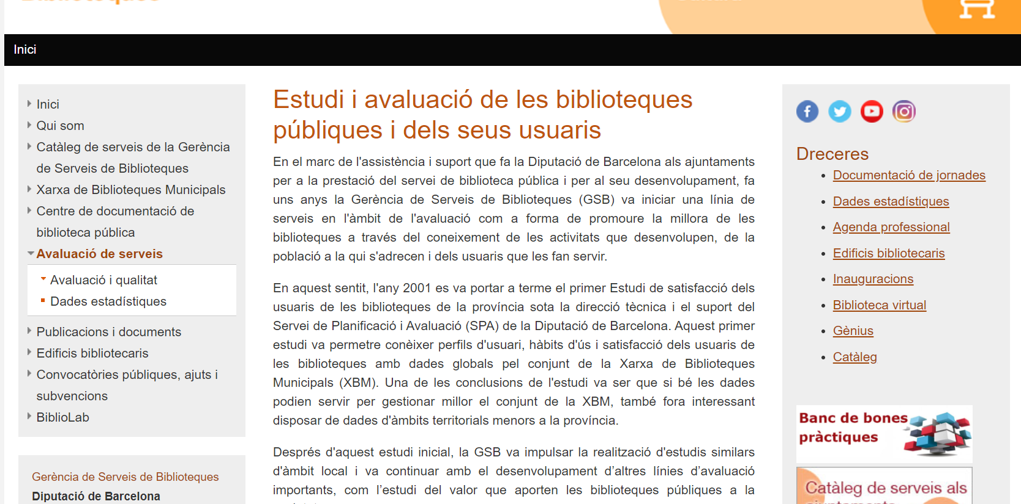


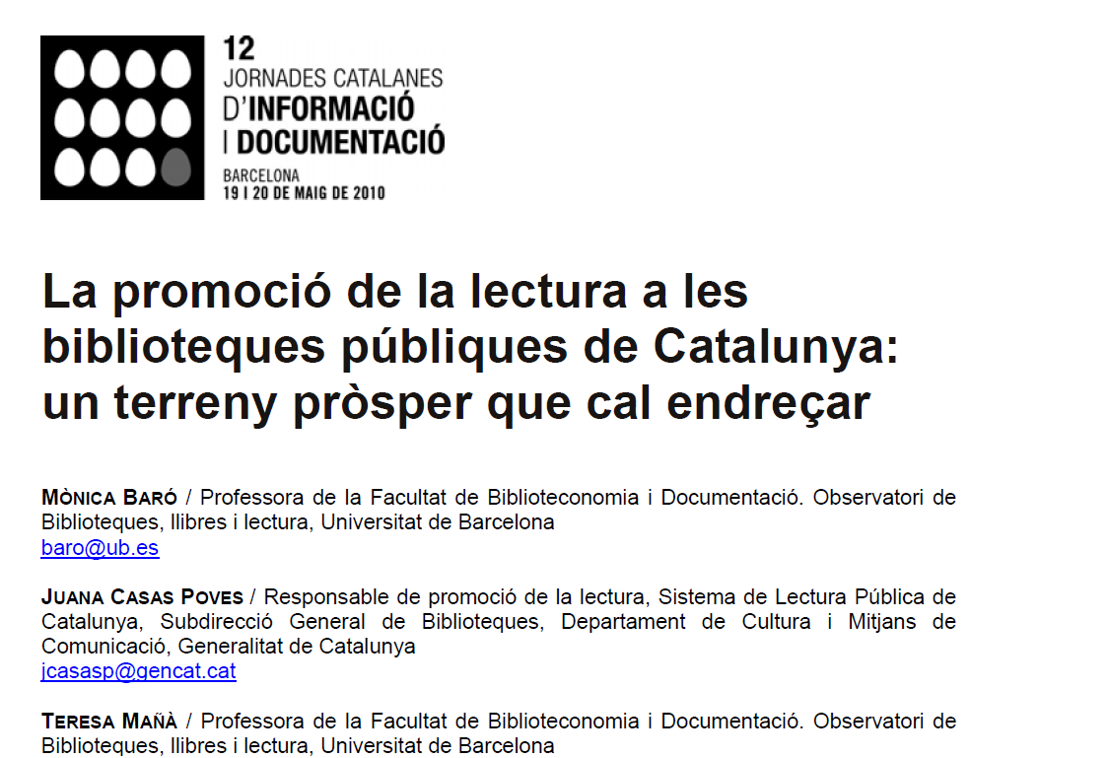

Criteris emprats en la cerca d’avaluacions​
Programes de característiques similars a l’entorn bibliotecari
Notes:
Finalment, podem pensar en aquelles situaicons no previstes o sobre les que la política pública té poc control, però que afecten als elements de la Teoría del Canvi que hem elaborat.
Des del punt de vista del disseny d’una política, si dientifiquem un risc important, podem pensar en accions de mitigació. Per exemple, en el context actual, si creiem que no seria estrany que s’endureixin les mesures de distanciament socia, podem pensar en altres formes de proveïr les tutories i el suport.

Slide 23
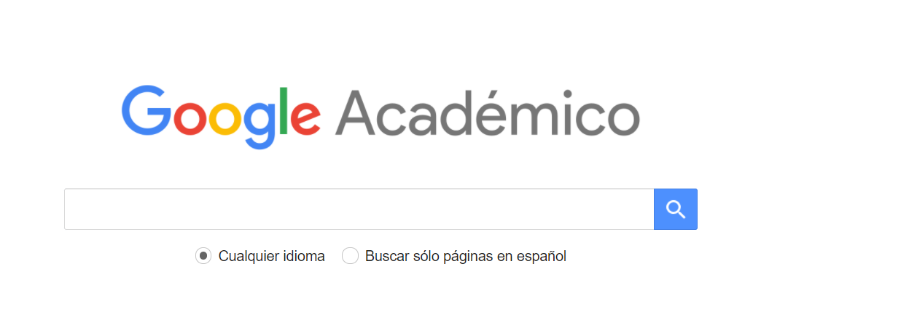
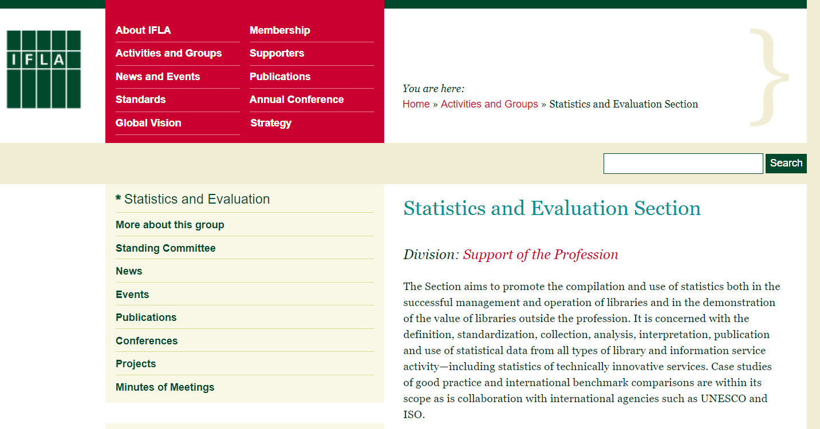
Criteris emprats en la cerca d’avaluacions​
Cerca de programes de “book challenges” o “reading challenges, amb o sense elements de ludificació
Notes:
Finalment, podem pensar en aquelles situaicons no previstes o sobre les que la política pública té poc control, però que afecten als elements de la Teoría del Canvi que hem elaborat.
Des del punt de vista del disseny d’una política, si dientifiquem un risc important, podem pensar en accions de mitigació. Per exemple, en el context actual, si creiem que no seria estrany que s’endureixin les mesures de distanciament socia, podem pensar en altres formes de proveïr les tutories i el suport.

Slide 24
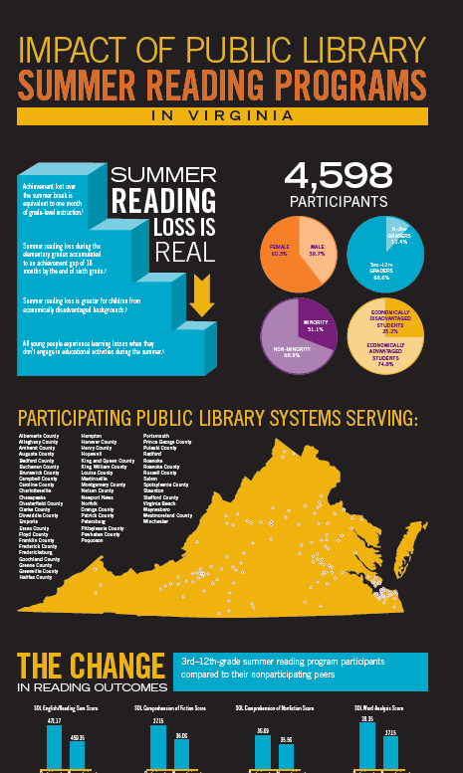
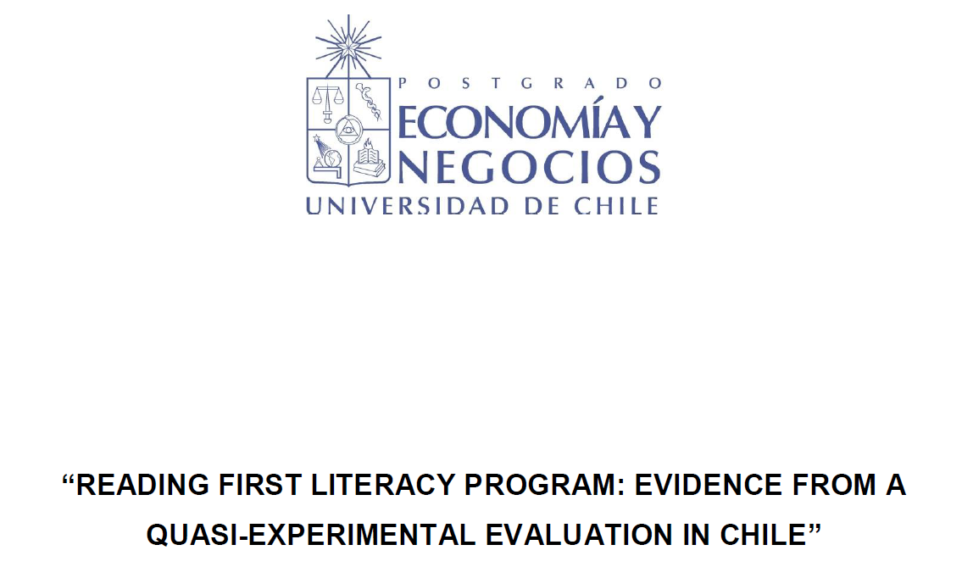
Criteris emprats en la cerca d’avaluacions​
Cerca de metodologies útils per al cas: quasi-experiments en altres contextos
Notes:
Finalment, podem pensar en aquelles situaicons no previstes o sobre les que la política pública té poc control, però que afecten als elements de la Teoría del Canvi que hem elaborat.
Des del punt de vista del disseny d’una política, si dientifiquem un risc important, podem pensar en accions de mitigació. Per exemple, en el context actual, si creiem que no seria estrany que s’endureixin les mesures de distanciament socia, podem pensar en altres formes de proveïr les tutories i el suport.

Slide 25
Conclusions de la cerca d’avaluacions​
No existeix una avaluació sistemàtica de programes de promoció de lectura.
Manca un marc per a l’avaluació d’aquest tipus de programes:
  Ajuden a promoure hàbit lector?
  Compleixen les previsions d’usuaris?
  En cas d’avaluar l’impacte quin mètode pot ser òptim?
Notes:
Finalment, podem pensar en aquelles situaicons no previstes o sobre les que la política pública té poc control, però que afecten als elements de la Teoría del Canvi que hem elaborat.
Des del punt de vista del disseny d’una política, si dientifiquem un risc important, podem pensar en accions de mitigació. Per exemple, en el context actual, si creiem que no seria estrany que s’endureixin les mesures de distanciament socia, podem pensar en altres formes de proveïr les tutories i el suport.

Slide 26
El Velocirepte al repositori d’avaluacions​
Utilitat per a direccions de biblioteca que impulsin programes similars.
  S’aporten models de qüestionari.
Referències sobre avaluacions d’implementació, on es posa el focus en els perfils d’usuari.
Un exemple d’avaluació d’impacte amb un mètode quasi-experimental (matching).
És compatible amb altres actuacions de difusió.
Notes:
Finalment, podem pensar en aquelles situaicons no previstes o sobre les que la política pública té poc control, però que afecten als elements de la Teoría del Canvi que hem elaborat.
Des del punt de vista del disseny d’una política, si dientifiquem un risc important, podem pensar en accions de mitigació. Per exemple, en el context actual, si creiem que no seria estrany que s’endureixin les mesures de distanciament socia, podem pensar en altres formes de proveïr les tutories i el suport.

