Slide 1
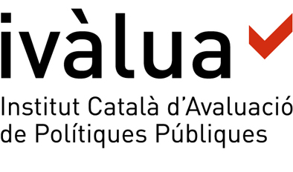
Núria Comas López & David Vílchez Álvarez
Are policy evaluations shaping policy-making?
Evidence from Catalonia
Context
The mission of the Catalan Institute for Public Policy Evaluation (Ivàlua) is to promote a culture of evaluation among public administration bodies and non-profit organizations in Catalonia. In order to accomplish its mission, among other activities, Ivàlua evaluates public policies on demand. From 2008 to 2016, Ivàlua has evaluated 33 public policies and programmes.
Research objectives
Obtain insights on how the evaluations carried out by Ivàlua have been used by organizations
Identify what changes in the design or implementation of evaluated policies have they triggered
Detect movements of the organizations towards a culture of evidence-based decision-making
Identify factors that make evaluations useful
Methods
We used a mixed methods approach. Data was collected from 32 out of 33 evaluations carried out by Ivàlua up to 2016.
Survey to the evaluations’ coordinators
Interviews with evaluations’ commissioners and users
Documentary analysis
Results
32 evaluations carried out
In addition to producing evidence to enhance policy design, evaluations can also bring additional opportunities for public administration and non-profit organizations. We identified that evaluations made by Ivàlua led to:
28 evaluations used for decision-making (88%)
4 (12%)
evaluations with no use
21 evaluations used for information purposes (88%)
7 (25%)
Evaluation capacity-building (changes in attitudes, knowledge, proceedings, institutions…)
evaluations resulted in changes to the design of public policies
Improvements in information systems
Among the evaluations which informed policy-making processes, 25% resulted in concrete changes to the design of public policies, such as adjusting or replicating the policy or programme. None of the evaluations was found to trigger the establishment, reduction or removal of a policy or programme.
Realization of further evaluations
Use and/or influence of the evaluation in other policies or institutions
Organizational learning and implications
We explored what factors promote or hinder the effective use of evaluations for decision-making and gathered some recommendations addressed both to evaluating agencies and to organizations responsible for public policy design and implementation.
Definition of the evaluation
Only evaluations with a clear purpose of use and a well-defined evaluation question should be carried out. This first stage is key to emerge expectations of commissioning organizations and make them aware of the learning possibilites that an evaluation can bring about.
Evaluation process
A close cooperation between the program-managing organization and the evaluating body is essential to ensure the evaluation meets existing needs. In this stage, evaluation skills and monitoring proceedings can be transferred, contributing to build a culture of evaluation.
Dissemination of results
A proper knowledge management system in the organizations responsible for the public policies is needed in order to expand the potential of use of evaluations’ results. Evaluating agencies should promote public presentations of the results to help evidence reach new audiences.
Follow-up of use
Follow-up actions to monitor use of evaluations are recommended. They can nudge policy-makers towards using evidence and help identify new evaluation needs. Besides that, data gathered should be used by evaluating bodies to design improvement strategies.

