Slide 1


Does Hosuing First catalyse a better life? Quantiative findings from a Catalan randomized control trial.
Institut Català d’Avaluació de Polítiques Públiques (Ivàlua)
Jordi Sanz

Slide 2
Main topics
The ‘problem’ of Homelesness in Barcelona
The rationale of Housing First models
The ‘Primer la Llar’ evaluation
Analysis and results
Conclusions and next steps

Slide 3
The problem of Homelesness in Barcelona

Slide 4

Homelessness in Barcelona: the numbers
The number of Homeless people in BCN has grown in recent years: from 2847 in 2016 to 3055 in 2018.
  Sleeping rough: 892 in 2016 while 1026 in 2018
  Sleeping in residential services: 1907 in 2016 to 2130 in accommodation services.
From a single-contact census (2017) is estimated that :
  25 % are women
  40% are aged between 31 and 50 years
  50 % are nationals
  45 % declare not having any regular income
Made up of 38 entities and the Barcelona City Council, XAPSLL is the organization behind the tally.

Slide 5

Homelessness in Barcelona: the ‘response’

Slide 6
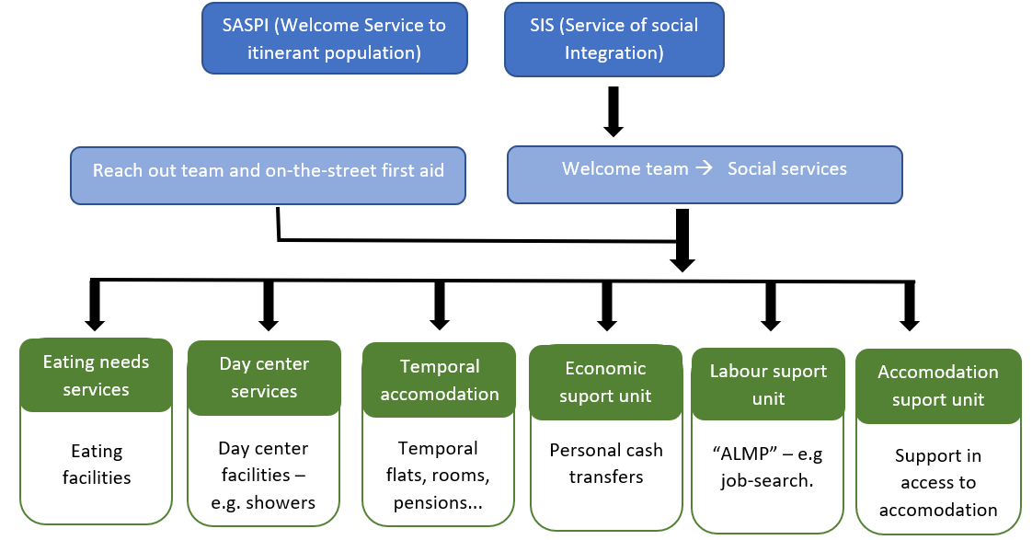
Homelessness in Barcelona: the ‘response’

Slide 7
Homelessness in Barcelona: the response
Residential and flats units doubled in the last 10 years.
There is the intuition that some profiles of homelessness are under served: long trajectories and with mental health problems/addictions

Slide 8
The rationale of Housing First models

Slide 9
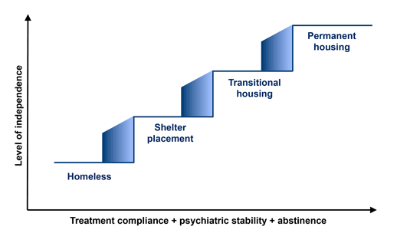
The ‘traditional’ service provision
Few arrive at the top of the ladder
Revolving door at the bottom of the ladder
Homelessness becoming more ‘elusive’

Slide 10
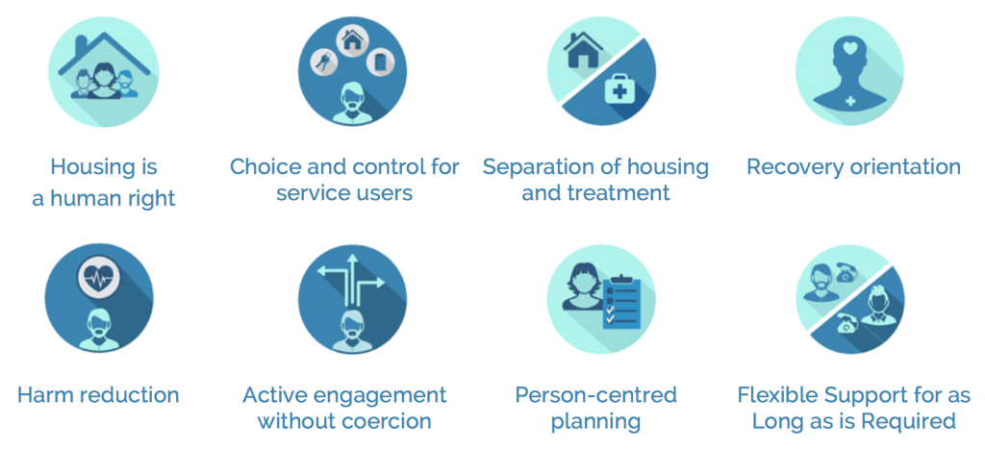
Principles of the Housing first
HF models consist of immediate access to housing with no housing readiness conditions with the following principles:

Slide 11
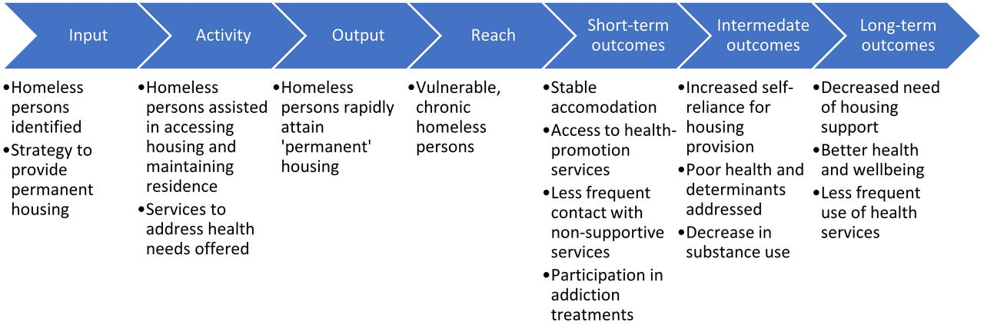
The theory of change of HF programs
‘Primer la llar’ program
manages 50 dwellings through the dep. of Social Rights
A pilot for three years (2015-2018)
Only for vulnerable homelessness: long trajectories and with mental health problems or drug addiction
Offers specialized social and mental health support
Budget: 3.000.000 euros (1 million/year).

Slide 12
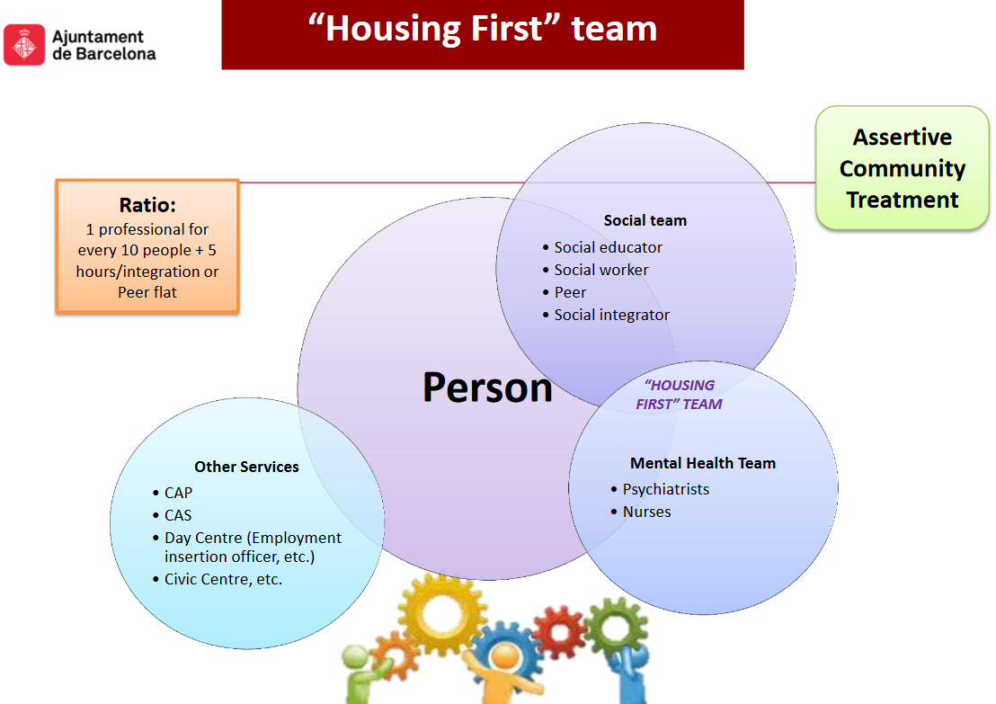

Slide 13
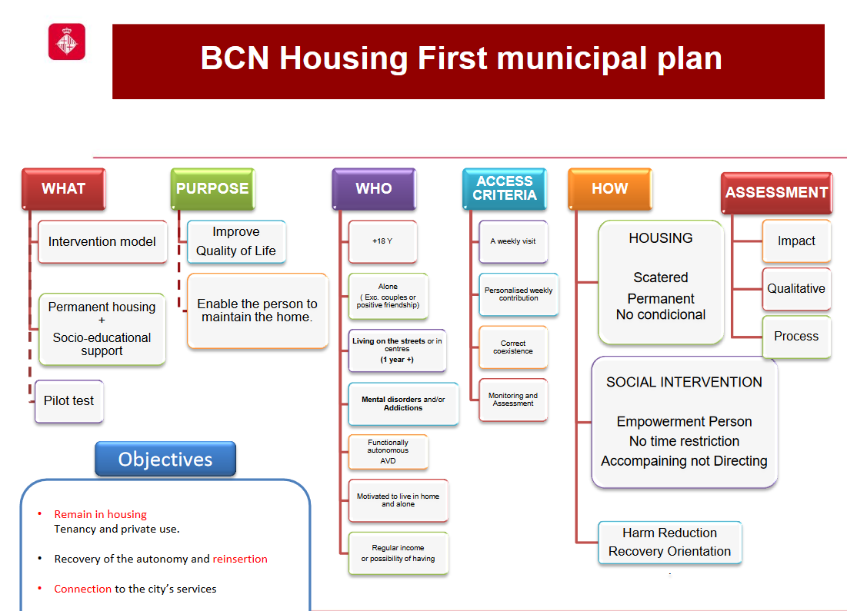

Slide 14
The ‘Primer la Llar’ evaluation

Slide 15
Evaluation: questions and technicalities
Eligibility criteria based on vulnerable homelessness:
  More than one year of being rough sleeper
  Having mental health problems or substance use disorders
  Accepting at least a weekly visit or contact of a professional
Recruitment while program open call resulting in 139 candidates: 50 randomly assigned to flats, 70 as comparison group and 19 being on reserve.
The main questions to be answered are:
  improvement of health related quality of live?
  Advance in personal self-recovery?
  Better social relationships?
Outcomes + measures t0-t3

Slide 16
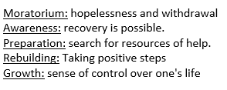
Evaluation: questions and technicalities
Health related quality of life was measured using the SF36, a validated scale with 8 subdimensions: physical functioning, physical role, emotional role, vitality, mental health, social functioning, bodily pain and general health
Personal recovery was captured using the Stages of Recovery instrument, a validated scale with 5 stages of recovery:
Social relationships were measured selecting 15 questions of the validated Social network survey on daily contact with friends and relatives, emotional support and perception of social relationships in general.

Slide 17
Analysis and results

Slide 18



Analysis and results
Results were obtained using a complete case analysis –using regression techniques to control for predictor variables of program attrition and non-response
‘Primer la Llar’ helps homeless people to move forward in their recovery process.
Nineteen months after randomization, the HF model participants were on average in a better situation with respect of mental health, bodily pain and health in general.
Twenty seven months after randomization, although positive correlations exist, statistically significant effects detected in month 19 vanish.
No effect has been detected in the social relationship of homeless people.

Slide 19
Analysis and results
Consort diagram

Slide 20
Conclusions and next steps

Slide 21
Conclusions and next steps
Our data suggests that the effects of ‘housing stability’ are not permanent on ‘personal stability’. The challenge of ‘obduracy’:
  “Housing First proponents regard stable housing to be a platform from which the (often long and complex) process of recovery from mental illness, substance misuse and/or social isolation might begin, not as a remedy to any or all of these problems per se” Tsemberis, S. (2010b)
‘Activation measures’ (on labor, skills, social life…) are necessary to ‘maintain personal stability alive’:
  Right after the ‘surviving mode’ is overcome.
  To avoid to answer the ‘not what’ question alone
  with certain degree of ‘conditionality’: evolving with also implies client responsibilities and commitments

Slide 22
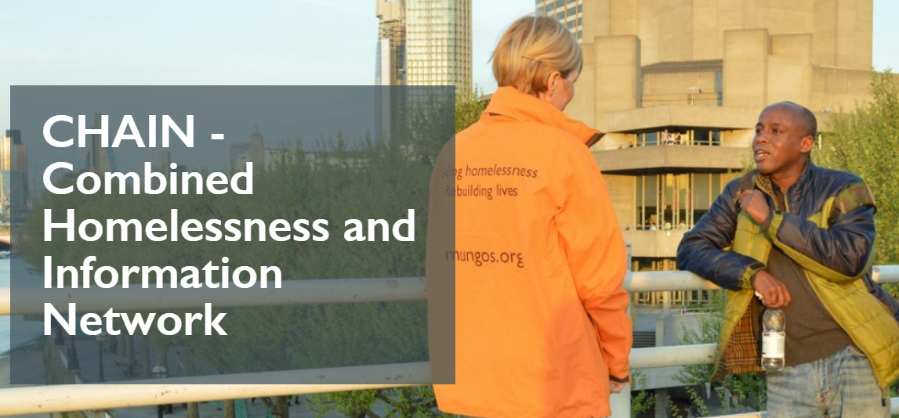
Conclusions and next steps
There is a need to improve tracking systems for homelessness:
  Would help to evaluate interventions – less attrition and non-response
  Would enhance coordination among services (outreach and detection)
Notes:
CHAIN is a multi-agency database recording information about people sleeping rough and the wider street population in London. The system, which is commissioned and funded by the Mayor of London and managed by St Mungo's, represents the UK's most detailed and comprehensive source of information about rough sleeping.
CHAIN allows users to share information about work done with rough sleepers and about their needs, ensuring that they receive the most appropriate support and that efforts are not duplicated. Reports from the system are used at an operational level by commissioning bodies to monitor the effectiveness of their services, and at a more strategic level by policy makers to gather intelligence about trends within the rough sleeping population and to identify emerging needs.
What information is recorded on CHAIN?
Basic identifying and demographic information
Information about people's support needs (for example mental health problems or substance use)
Information about people’s circumstances prior to rough sleeping
Contacts made with outreach workers on the street (i.e. instances of people being seen rough sleeping)
Key outcomes, actions and events (including arrivals at and move on from accommodation)

Slide 23
Conclusions and next steps
Alternative understanding of social service provision: not about individual meritocracies ladders but enacting windows of opportunity
Next steps include:
  cost-effectiveness in the use of council social services plus health services in general and mortality
  to contrast our conclusions with the corresponding qualitative evaluation of ‘Primer la Llar’
  To promote lessons learnt from ‘Primer la Llar’ evaluation

Slide 24
Thank you!
@Ivalua_cat

Slide 25
Annexes

Slide 26
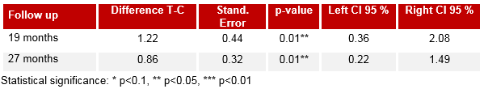
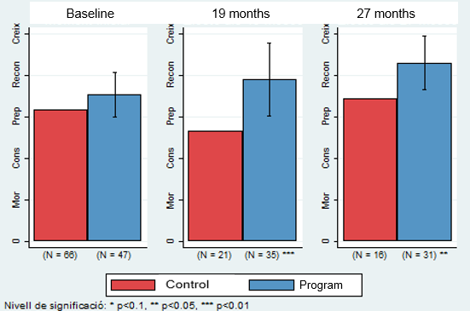

Recovery
Notes:
Phases in STORI: moratorium, Awareness, Preparation, rebuidling and growth

Slide 27
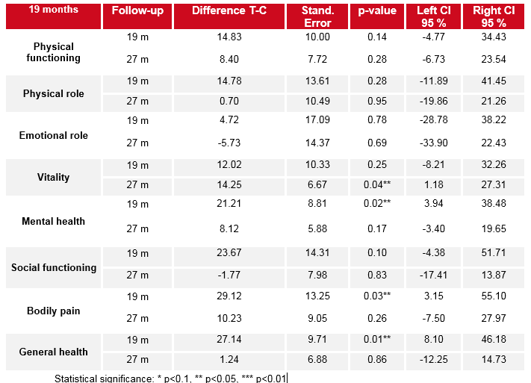
Health related quality of life (SF36)

Slide 28
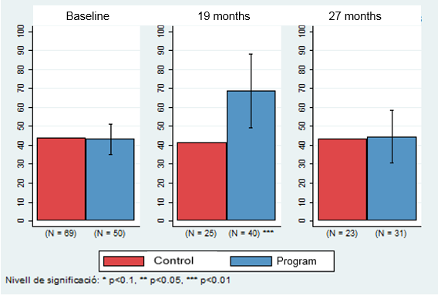
Health related QoL (SF36): general health

