Slide 1
Moving evidence-based policy forward: the contribution of Ivàlua
Institut Català d’Avaluació de Polítiques Públiques (Ivàlua)
Round table “Moving Evidence-Based Policy Making Forward at the Regional and Local Level”
Jordi Sanz

Slide 2
Main topics
The Catalan Institute of Public Policy Evaluation
What are the main barriers for the institutionalization of evaluation?
Our proposal to overcome barriers

Slide 3
The Catalan Institute of Public Policy Evaluation

Slide 4
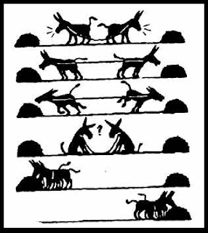

Slide 5
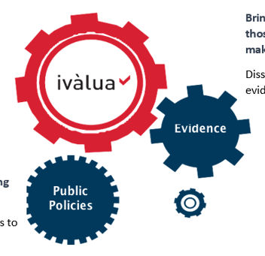

Slide 6
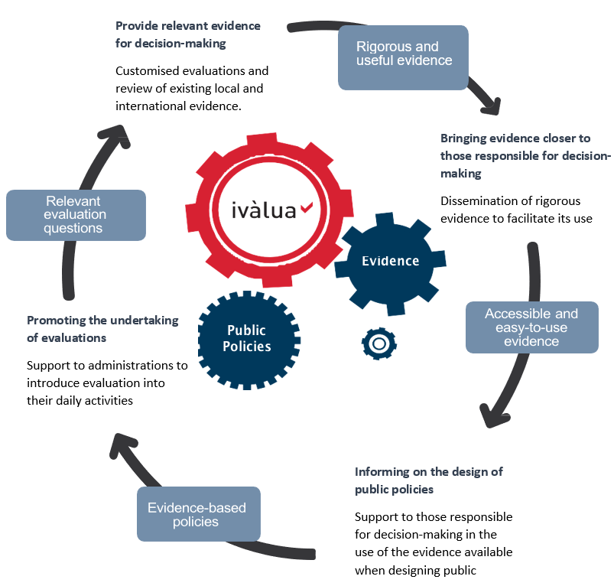

Slide 7
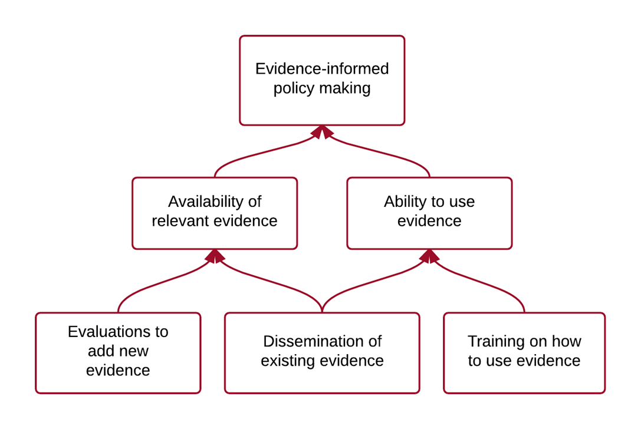
Ivàlua, the mission:
To promote the evaluation of public policies, and programmes of the third social sector in Catalonia, improve their effectiveness, efficiency and transparency.
Diagnosi:

Slide 8
Ivàlua, the activities:
We carry out evaluations of local and regional public policies for their improvement.
We ‘translate’ local and international evidence to provide rigorous knowledge.
We train decision-makers in the use of evidence for policy design, evaluation questions and their commission
We offer accompaniment resources to help incorporate evaluation into daily activities.
We disseminate the results of our own evaluations as well as international evidence to bring them to decision-making.
Notes:
We carry out evaluations of local public policies to help improve them design, implementation, efficiency and effectiveness.
We summarise local and international evidence to provide knowledge on specific themes.
We train public decision-makers and technicians from the administrations in the use of evidence for decision-making, the definition of evaluation questions and the commissioning of evaluations.
We offer accompaniment and training resources to public administrations and third-sector institutions to help them incorporate evaluation into their activities.
We disseminate the results of our own evaluations as well as international evidence to bring them to those responsible for decision-making and to citizens.

Slide 9
Ivàlua, the added value:
The first and only public institution devoted exclusively to the evaluation of public policies in Catalonia.
Multidisciplinary teams with expertise in methodologies for the evaluation of public policies.
A direct relationship with administrations.
A broad knowledge of the local context and of public policies carried out in Catalonia.
Use of qualitative and quantitative methods.
Support of experts from the university world and from independent professionals.
Transparency of the actions carried out.

Slide 10
The main barriers to evaluation

Slide 11
The main barriers to evaluation
Misunderstanding of the evaluation: with monitoring activities, economic audit, organizational or management audit, etc.
Lack of mechanisms to stimulate the demand for evaluations from ‘the very beginning’ and to predict their use in decision-making and resource allocation processes.
Lack of articulation of domestic evaluators – which have a ‘diversity’ of evaluation definitions
Lack of sufficient internal technical capacity of administrations to promote and define evaluation processes.

Slide 12
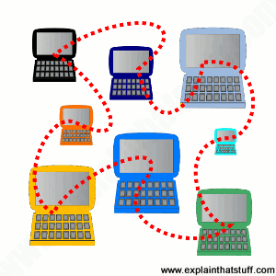
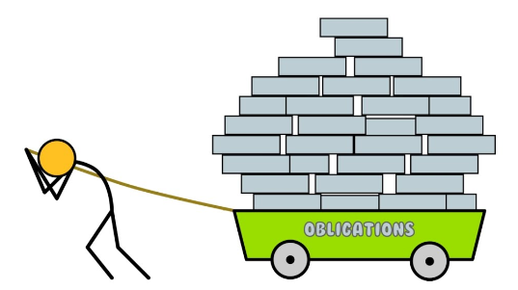
The main barriers to evaluation
Underutilization of existing administrative records for evaluation purposes.
Lack of effective mechanisms for knowledge transfer from the academic world to the administrations.
Diverse degree of institutionalization in public administration that ensure that evaluations have some utility: existence of an evaluation unit or a budget for evaluation
Existence of regulatory approaches that formally impose ‘evaluation’ obligations on administrations that do not yet have the training and the technical and material means to enforce it.

Slide 13
A selection of activities to overcome barriers

Slide 14
A selection of activities to overcome barriers
Thinking of evaluability assessment as prior to any evaluation – Evaluability assessment tool with the Department of Economy.
Designing both program and evaluation from the very beginning – Evaluation of Activa’t per la Salut Mental.
Innovating in capacity building following a hands-on approach – Strategic Workshops with the Round Table of the Third Sector.
Widening the ‘What Works’ to several fields of knowledge –education, labour policies for youth, social services, gender...

Slide 15
A selection of activities to overcome barriers
Enacting an evaluation community at both sides (demand and supply) – Community of evaluation together with the Department of Economy and our ‘Evaluators network’.
Co-working all the necessary to evaluate with partners – e.g. evaluation questions, theories of change or information systems – Assessment to the Catalan Agency for International Cooperation.
Moving from single to evaluation agendas – Agenda in the evaluation of Active Labour Market Policies

Slide 16
Thank you! @Ivalua_cat

