Slide 1
Barcelona’s child cash transfer scheme
Jaume Blasco and Fede Todeschini

Slide 2
Program results
Impact theory
Increased consumption of goods & services aimed at children’s basic needs
Increased household income
Increased child welfare
Benefit
Increased adult welfare & home environment
Time released for education or job search

Slide 3
Program design evolution
Year | Social eligibility criteria | Means-test threshold | Amount of financial aid provided | Complement for lone parents
2015 | Social Services needs assessment | Meal grant beneficiary (f4: <16.451 € per year) | 100€ per child & month | None
2016 |  | Earnings, from the tax information system (f4: <17.927 € per year)
2017 | Social Services needs assessment from the prior year |  | 100€ per child & month + a 900 € annual cap per child + amount reduction for second (75€) and third or higher order children (50€) | 100€ per family & month + 900 € annual cap per family
2018 | Restricted to beneficiaries (from the prior year) of social care programs aimed at the most vulnerable families
2019 |  |  | Annual cap per child lowered to 800 € | Annual cap per child lowered to 800 €

Slide 4
Program design evolution
Declining number of beneficiaries
More restrictive eligibility criteria
Economic and employment improvement-> reduction of the target population?

Slide 5
Program design evolution
Declining average amount of benefit (including complement)

Slide 6
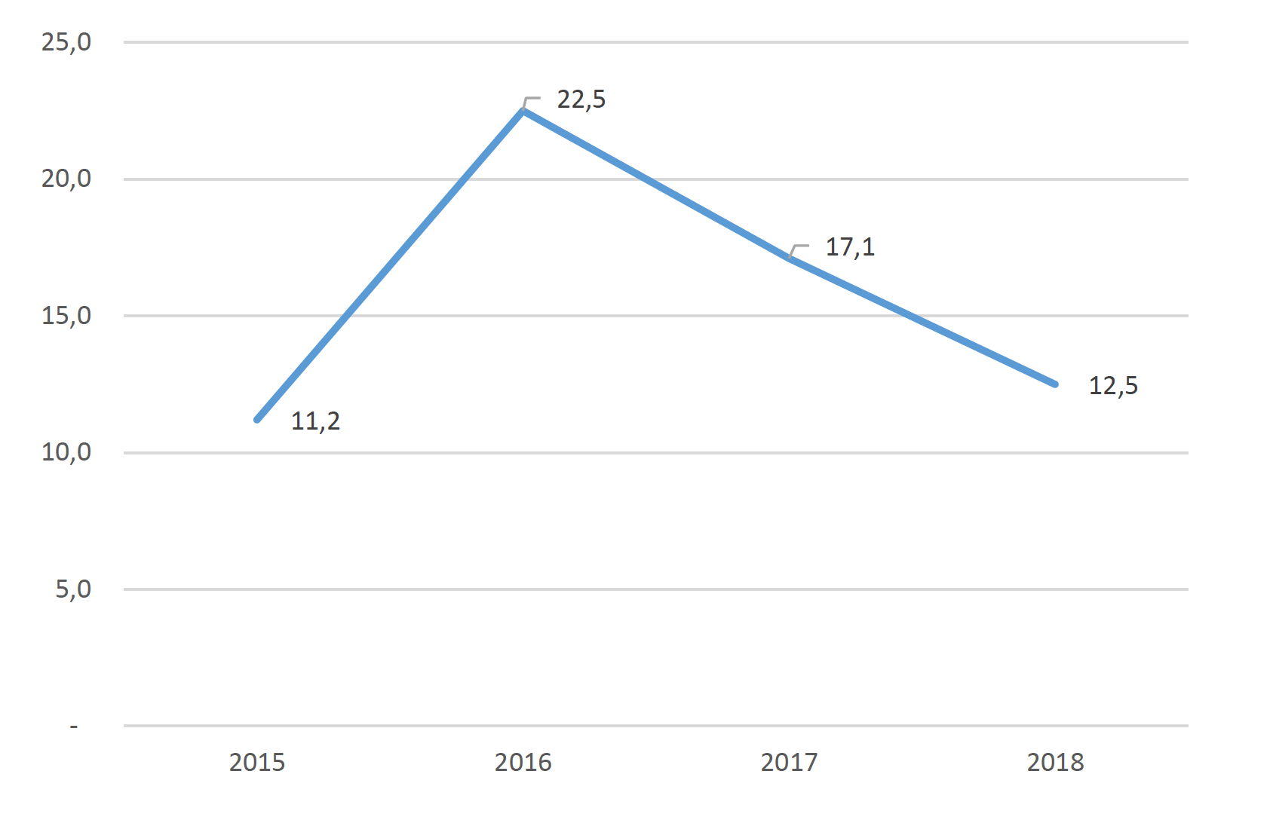
Program design evolution
… declining budget

Slide 7
Child poverty in Barcelona
 | Sample of Tax Agency records, BCN 2015 | EMCV, BCN 2016-17
At risk of poverty threshold (<60% of median; single adult households) | 11.005,2€ | 11.122,4€
Children at risk of poverty rate | 30,9% | 29,5%
At risk of severe poverty threshold (<30% of median; single adult households) | 5.502, 6€ | 5.561,2€
Children at risk of severe poverty rate | 14,2% | 5,4%

Slide 8
Child poverty in Barcelona
Absolute poverty: A basic basket of goods and services is defined normatively; the cost of the basket is estimated based on local prices; the % of families unable to meet this cost is computed.
Reference Budget: 5.253,2 € annually, for single-person households, excluding private transportation and housing expenses (2014 with small family economies of scale (for instance, 2nd adult 73%; 1st child, 75%; 1st teenager, 103%) (ImPRovE estimation)
Adaptation:
Actualise prices of the basic baskets to 2015
Include housing costs: (percentile 30 of the distribution of renting prices per m² of the “great district” where the family lives + percentile 30 of utility costs per m² for the city) * (reference 40 m² size assigned to households up to two people + 10 m² per additional member) (ESD 2017 deflated to 2015)
Adaptation of the equivalence scale: 0,73 for 2nd and higher adults >18; 1,03 for all infants 14-17; 0,525 for all infants <14

Slide 9
Child poverty in Barcelona
 | Sample of Tax Agency records, BCN 2015 | EMCV, BCN 2016-17
At risk of poverty threshold (<60% of median; single adult households) | 11.005,2€ | 11.122,4€
Children at risk of poverty rate | 30,9% | 29,5%
At risk of severe poverty threshold (<30% of median; single adult households) | 5.502, 6€ | 5.561,2€
Children at risk of severe poverty rate | 14,2% | 5,4%
Absolute poverty threshold | Varies according to district rental prices
Children in absolute poverty | 26,6%

Slide 10
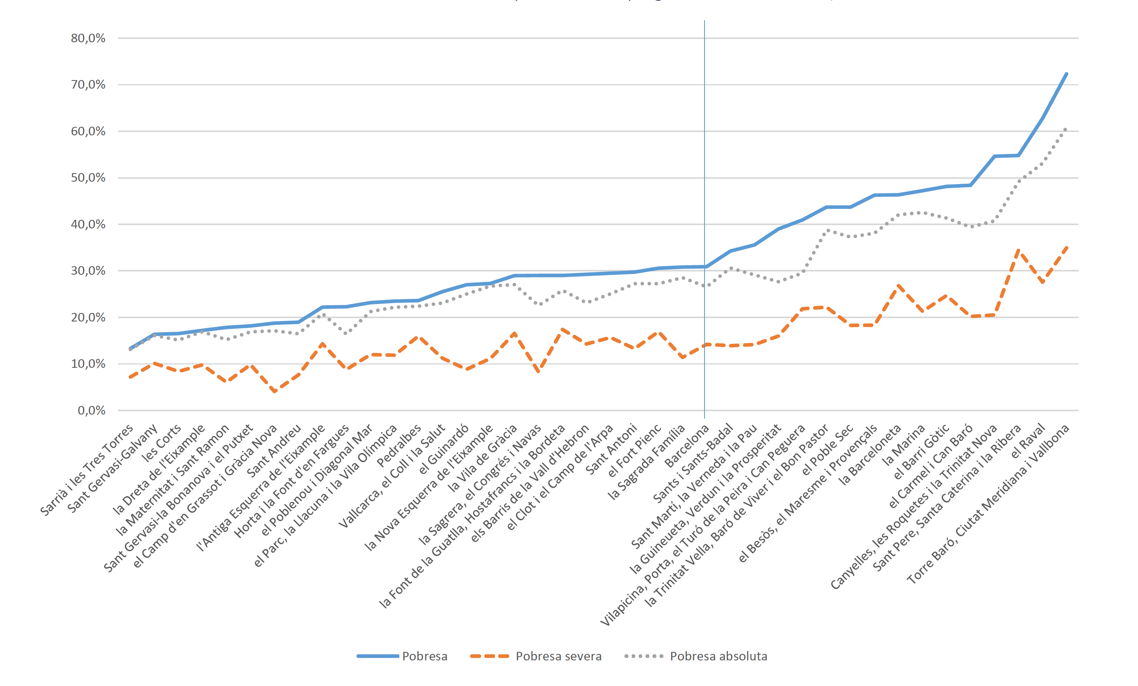
Child poverty in Barcelona
Elevated rates in certain districts, >50% of children at risk of poverty in 4
Child poverty rates by districts
Great disparities, from 13,3% to 72,3% (4,1%-35,0%)
Rates surprisingly high in wealthy districts (minimum at 13,3%)
Pedralbes: 23,6% at risk of poverty and 16,0% at risk of severe poverty!
Poverty
Severe poverty
Absolute poverty

Slide 11
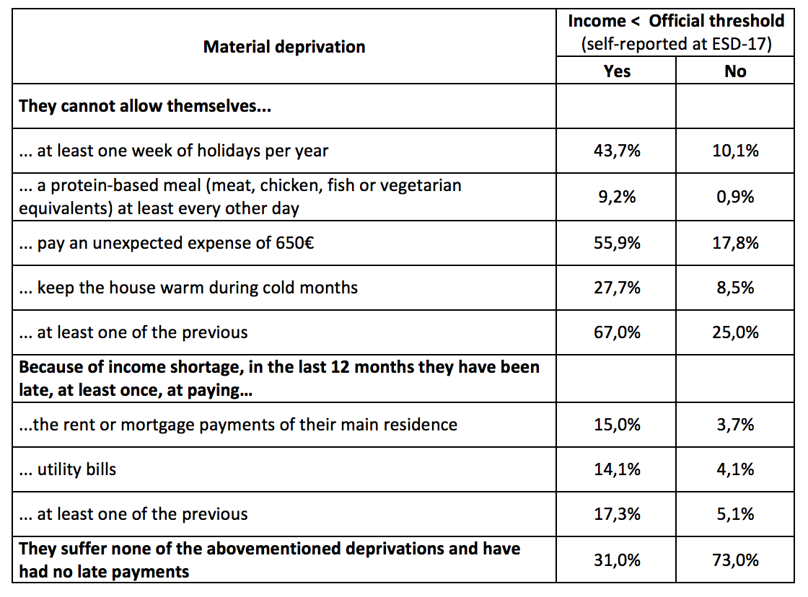
Child poverty in Barcelona
ESD-2017 allows to analyse the association (at the family level) between monetary poverty (income < normative threshold determined by the Catalan Government) and several measurements of material deprivation

Slide 12
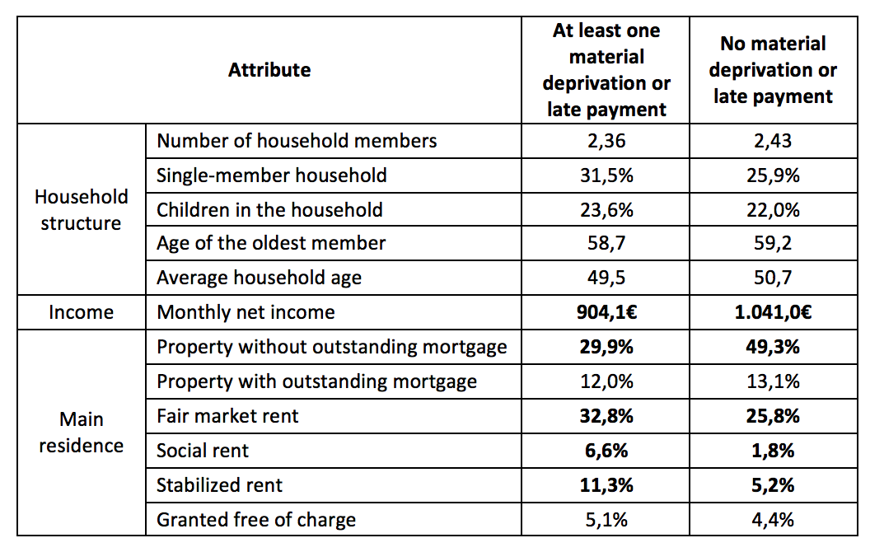
Child poverty in Barcelona
ESD-2017 allows to analyse the association (at the family level) between monetary poverty (income < normative threshold determined by the Catalan Government) and several measurements of material deprivation
Families with an income < official Catalan threshold

Slide 13
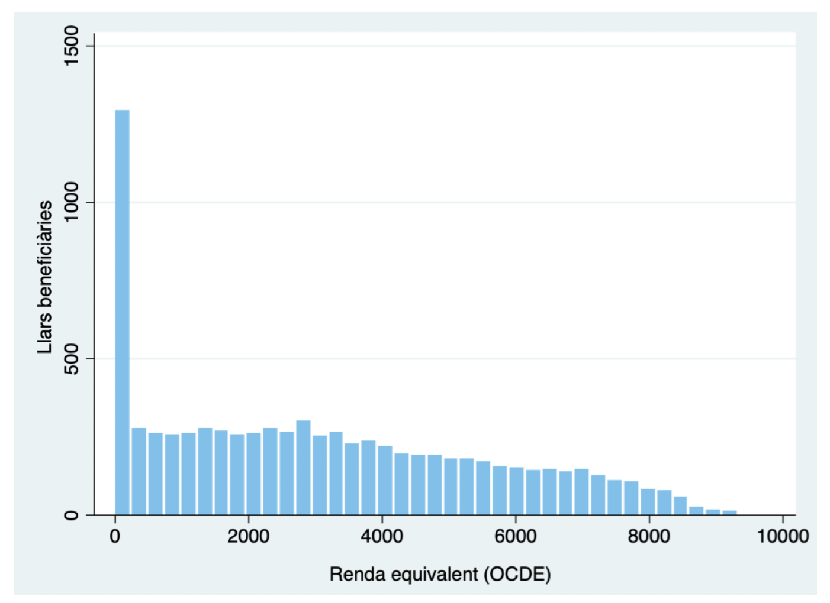
Beneficiary characteristics
Equivalized gross income histogram, 2018
12,6% of beneficiary families earn an equivalized gross income <=0
Number of recipients (households)
Equivalized gross income (OECD-Oxford)

Slide 14
Beneficiary characteristics
Age of beneficiary children, 2018

Slide 15
2017-2018 dynamics
Beneficiary characteristics | 2017 |  | 2018
 | Only 2017 | Continues to 2018 | New in 2018 | Coming from 2017
Number of beneficiaries per family | 1,70 | 1,82 | 1,65 | 1,81
Age of youngest child | 6,9 | 6,5 | 6,3 | 7,2
% lone parents | 16,0 | 25,4 | 22,0 | 32,2
% Spanish nationality (child) | 95,1 | 94,6 | 93,3 | 94,6
Gross household income | 7.109,0 € | 5.742,4 € | 6.304,0 € | 5.906,0 €
Gross equivalised income | 3.485,4 € | 2.900,2 € | 3.251,1 € | 2.953,6 €
% at risk of severe poverty | 74,8 | 86,6 | 79,3 | 84,4

Slide 16
2017-2018 dynamics
Beneficiary characteristics | Beneficiaries in 2017 & 2018
 | 2017 | 2018
Number of beneficiaries per family | 1,82 | 1,81
% lone parents | 25,4 | 32,2
% Spanish nationality (child) | 94,6 | 94,6
Gross household income | 5.742,4 € | 5.906,0 €
Gross equivalised income | 2.900,2 € | 2.953,6 €
% at risk of severe poverty | 86,6 | 84,4

Slide 17
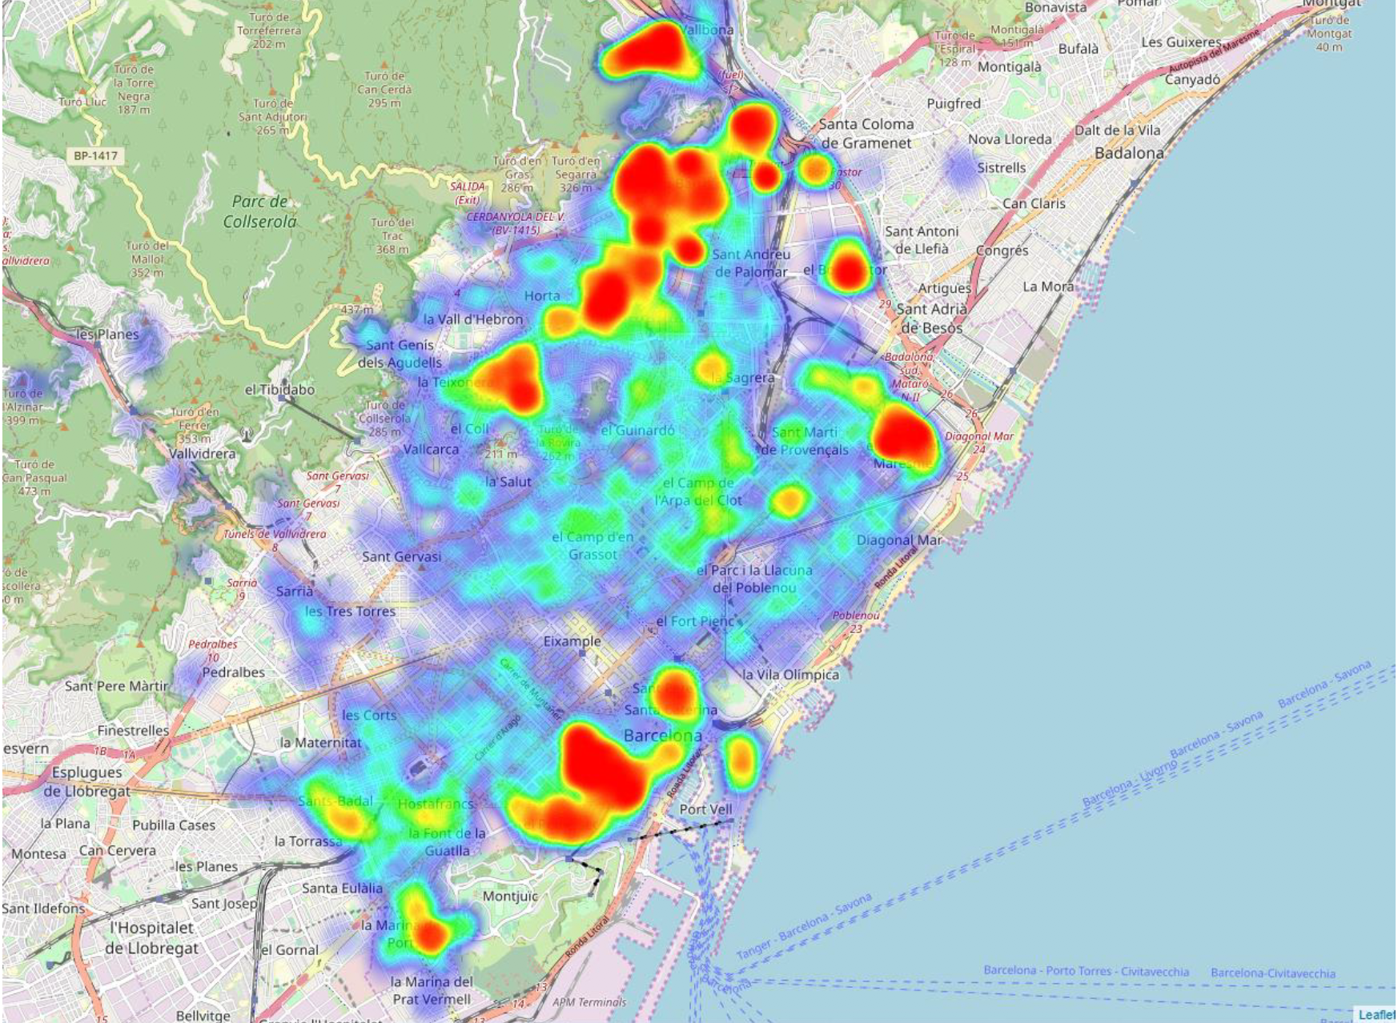
Program design evolution
Geographic distribution (2018)

Slide 18
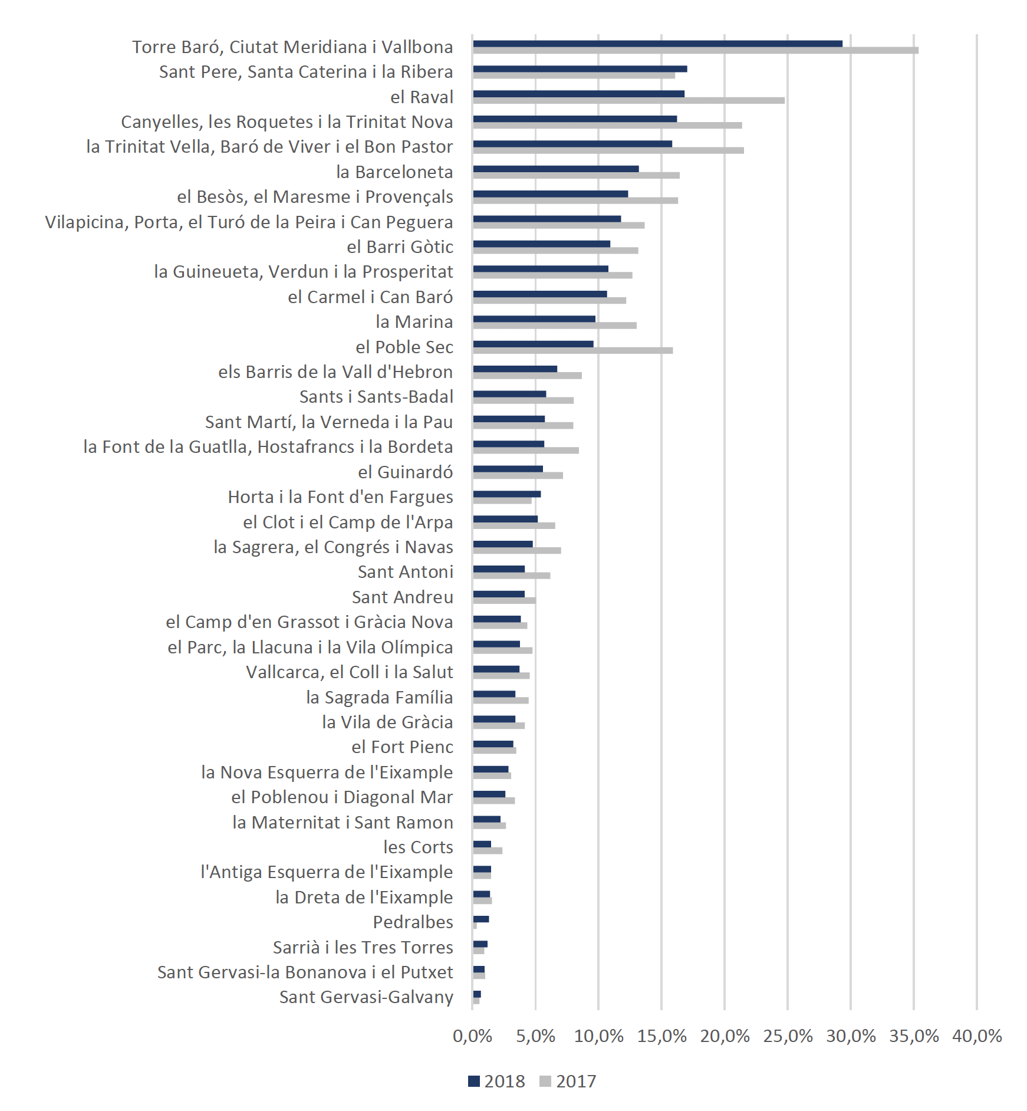
Coverage rate
Total children covered by the program: 8,0% (2017) 6,3% (2018)
Maximum at Torre Baró, Ciutat Meridiana i Vallbona (35,4% i 29,3%)
Effect of restrictions in access introduced in 2012 varies largely from district to district

Slide 19
Coverage rate
% of total infants at risk of poverty / absolute poverty
Stability of the target population (at risk of poverty or absolute poor) is artificial and stems from the limitations of our dataset. We have estimated relative and absolute poverty rates using a 2015 distribution of incomes, and then we have assumed that these rates remain stable throughout 2017

Slide 20
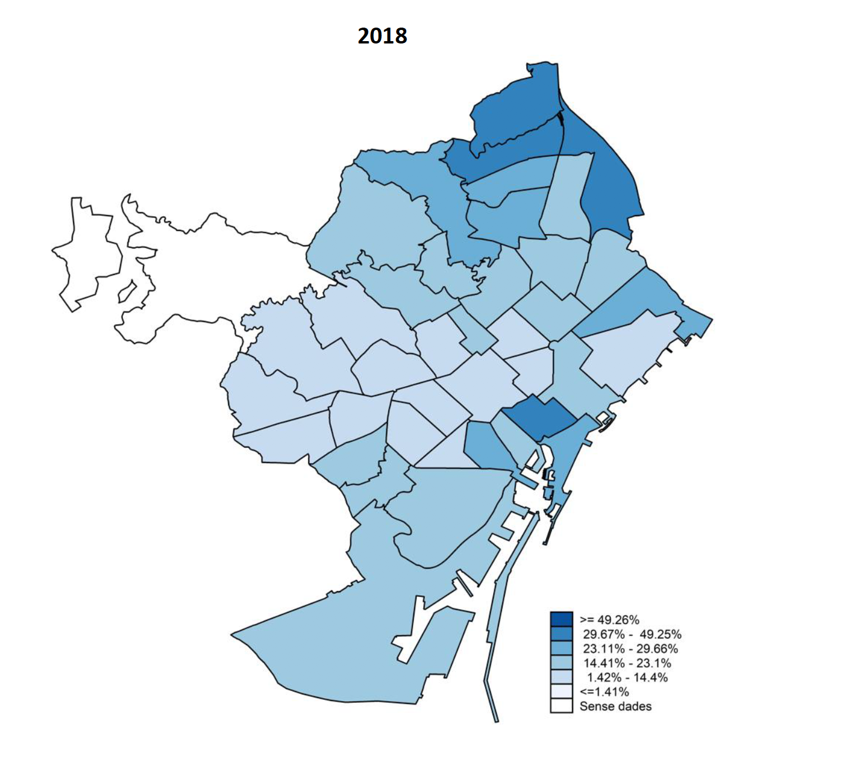
Coverage
Large territorial disparities in coverage
Maximum: Torre Baró, Ciutat Meridiana i Vallbona
Minimum: Sant Gervasi-Galvany
At risk of poverty: from 4,0% to 40,6%
At risk of severe poverty: from 5,4% to 72,5%
In absolute poverty: from 4,0% to 48,3%
No data

Slide 21
The larger the median income of the district, the lower the % of children at risk or in absolute poverty that are covered by the program

Slide 22
Possible explanations
Measurement error: In a relatively wealthy neighbourhood, it is more likely that a very low income does not indicate a situation of real material deprivation (because of savings, estate, support from other households, informal income, income abroad, etc.)
Shame of poverty: All else equal, in a relatively wealthy neighbourhood a very low income family is less likely to be a Social Services’ user because of fear of stigmatization. Alternatively, situations of financial poverty without additional social problems may be more common in wealthier districts.

Slide 23
Targeting efficiency
% of beneficiaries at risk of poverty / absolute poor
In 2018, 20.000 children at risk of severe poverty did not get the benefit, whereas 2.500 at risk of non-severe poverty did.
All who claim the benefit get it, as long as they fulfil the requirements. Hence, the explanation lies in social services use or in the program take-up among at risk of severe poverty families
Changes in criteria of 2017 improved the efficiency, but those of 2018 did not.

Slide 24
Basic needs coverage
% basic expenses covered by the program
Nth child | Amount | Reference budget (103%) | Reference budget (75%) | % of reference budget covered by the program
1st | 100 € | 264,6 € | 192,7 € | 37,8% | 51,9%
2nd | 75 € | 264,6 € | 192,7 € | 28,3% | 38,9%
3rd or higher | 50 € | 264,6 € | 192,7 € | 18,9% | 26,0%
Computed for 2018, for which the monthly reference budget adds up to 256,9 € for a single adult, excluding private transportation and housing expenses. Computations valid for those months in which the benefit is provided, disregarding the 900 € per year and child cap.

Slide 25
Program results
Child poverty reduction
2017 | Before program | After program | Reduction (children) | Reduction (%)
At risk of poverty | 17.515 | 17.515 | 0 | 0,0%
At risk of severe poverty | 14.292 | 12.760 | 1.532 | 10,7%
Absolute poverty | 17.457 | 17.282 | 175 | 1,0%
2018 | Before program | After program | Reduction (children) | Reduction (%)
At risk of poverty | 13.800 | 13.800 | 0 | 0,0%
At risk of severe poverty | 11.341 | 10.279 | 1.062 | 9,4%
Absolute poverty | 13.772 | 13.666 | 106 | 0,8%

Slide 26
Program results
Child poverty gap reduction
2017 | Before program | After program | Reduction (M €) | Reduction (%)
At risk of poverty | 163,5 M€ | 146,4 M€ | 17,2 M€ | 10,5%
At risk of severe poverty | 54,3 M€ | 41,0 M€ | 13,3 M€ | 24,6%
Absolute poverty | 135,0 M€ | 118,0 M€ | 17,0 M€ | 12,6%
* Poverty gap reduction for the beneficiaries
2018 | Before program | After program | Reduction (M €) | Reduction (%)
At risk of poverty | 130,4 M€ | 117,9 M€ | 12,5 M€ | 9,6%
At risk of severe poverty | 44,7 M€ | 34,8 M€ | 9,9 M€ | 22,2%
Absolute poverty | 111,2 M€ | 98,7M€ | 12,4 M€ | 11,2%

Slide 27
Child poverty gap reduction
The poverty gap for all families with children in Barcelona is 478,8 M€. The program implies a reduction of 3,6%. Additional 461,6 M€ would be required to eradicate child poverty in the city.
The severe poverty gap for all families with children in Barcelona is 119,6 M€. The program implies a reduction of 11,1%. Additional 106,3 M€ would be required to eradicate severe child poverty in the city.
Using the 2018 average benefit (907,1 € per year and child), additional 48,9 M€ would be required to cover all infants at risk of poverty, 17,9 M€ to cover all infants at risk of severe poverty, and 40,4 M€ to cover all infants in absolute poverty.

Slide 28
Limitations
Obviously, the benefit’s impact on household income is not mechanistic. Actual benefits and expectations of future benefits may alter recipients’ work behaviour, which may in turn:
Reduce income, if they work less because they have already secured the income from the benefit and/or because they (often correctly) fear that they will lose their right to the benefit if their work income increases too much.
Increase income. If basic needs are covered by the benefit, time is released to look for a (better) job or get into training programs.
We do not know the benefit’s impact on household expenses or on children’s wellbeing.

Slide 29
Recommendations
Stop reacting to budget constraints with uniform benefit caps that affect equally a rather heterogenous population of recipients. Instead:
Focus and reduce the target population: which families are more in need of an unconditional and regular financial aid, detached from the relationship and discretional decisions of social care workers? (not necessarily the poorest, since other forms and sources of aid are available; focus on social eligibility criteria?)
Phase out the benefit, based on family income (3 or 4 levels)
Specify in the call how the family income is computed, and ideally adjust the procedure to other financial aid programs aimed at the same target population, such as meal grants

Slide 30
Recommendations (II)
Adjust the amount of the lone-parent complement according to the parent income, or replace it for a privileged formula in income computation (so that not-so-poor lone parents can access the benefit)
Develop a better analysis and understanding of 1) validity of previous year family income as an indicator of child poverty, particularly in high income districts; 2) low program take-up among at risk of severe poverty families; 3) effect of the benefit on the relationship between social care workers and family adults, and on the reception of other sources of financial aid 4) program impact on families’ income, consumption and children’s welfare

